Slide 1
customer analysis
Group 1 DA
Aiman, Aiffa, Nazihah,
Anis, Puteri, Imran

Slide 2
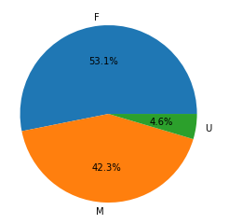
Female customers dominated the market with almost 11% higher than male customers
We propose for the management to add more market segment for male customers to increase sale
Female
Unknown
Male
Notes:
From the pie chart, it can be seen that the number of female customers, 53.1% is higher than male, 42.3%
For the unknown, we agreed that some customers may not want to disclose their genders due to personal reasons.
Female cust, dominated with almost 11% higher than male
Propose to add more market segment to attract male customers

Slide 3
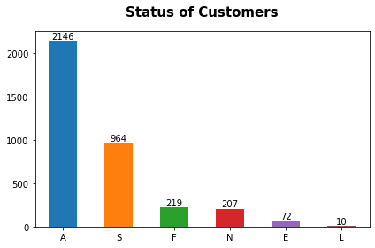
Active customers accounts for 86% of the market
Active customers
New customers
Inactive customers
Notes:
Our customers are divided into 3 categories which are active, new & inactive
and Active cust accounts for 86% of the market, which consists of around 3,000+ customers
In order to increase sale of this product, This is where the marketing team will take action and strategize plans to attract & retain customers, whether they are active, new or inactive

Slide 4
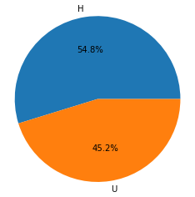
54.8% of customers possess their own property
With property
Undisclosed
Notes:
We now want to dig deep into our customers’ demography to understand their purchasing behaviour better
So according to our data, 54.8% of the customers owns their own property
So you must be wondering why do we study their property possession?
The reason why we collect and analyze this property possession data is bcs we can deduce that customers with property have stable income and salary to continue purchasing our products
- For those 45.2% who do not disclosed their data, we can make use of their annual income data instead.

Slide 5
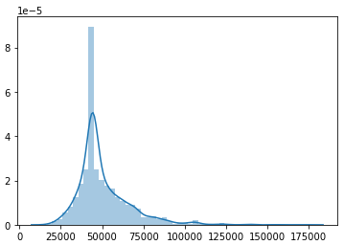
Average annual income is around USD40,000
Higher salary, higher purchasing power
Notes:
Purchasing power = the financial ability to buy products and services.

Slide 6
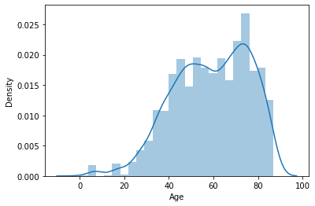
More than half of customers are of 40 to 80 years old
We suggest to maintain good relationship with these customers using traditional marketing methods like phone calls, text messages and emails.
Push trendy promotions for adults of 20 above
Notes:
More than half of cutomers age 40 – 80 years old,
maintain good relationship with these customers using traditional methods like phone calls, text messages and emails.
Push promotions for adults of 20 above, trendy ads like thru tiktok and instagram

Slide 7
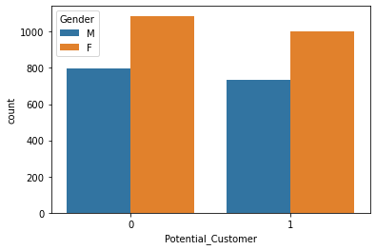
There is an equal amount of potential customers and non-potential customers among both male and female
Notes:
So how to attract more these potential customers?
Let me show you the correlation with our promotional ads stats

Slide 8
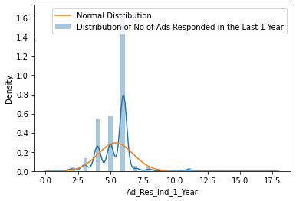
Customers responded more than 6 times since last year
Insight: Great promotional ads

Slide 9
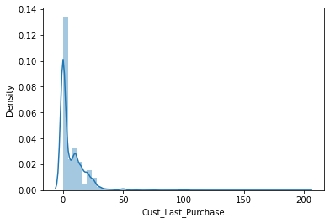
Customers click the ads, however, they are not interested in purchasing the products
Suggestion: Update website (UI/UX design) and have variety of payment options during checkout

Slide 10
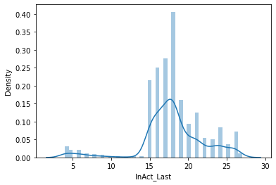
The inactive number of months since the last purchase is 15 months and above
Once a year promotional ads
Attract and retain regular and casual customers

Slide 11
THANK YOU ☺

